Slide 1
Building a Team in Parks Maintenance

Slide 2
Intro/Overview
Why Glenn and Angie?
Parks Maintenance Cultural Change Project
Background and Context
City of Edmonds, early 2020
New Director, COVID on-set, disgruntled work team
Downtown Park with $15M renovation
New 2+ miles of Highway 99 landscape median

Slide 3
Theory to Real World
Questions to Answer
Discussions
What is Morale and why does it matter
Does everyone dislike change?
How Do I communicate?
Maintenance Worker Bias?
Developing a championship team, individual and leaders!
The Power of Purpose
Do it with them not to them
There are no secrets
It’s a different language
Yes you can!

Slide 4
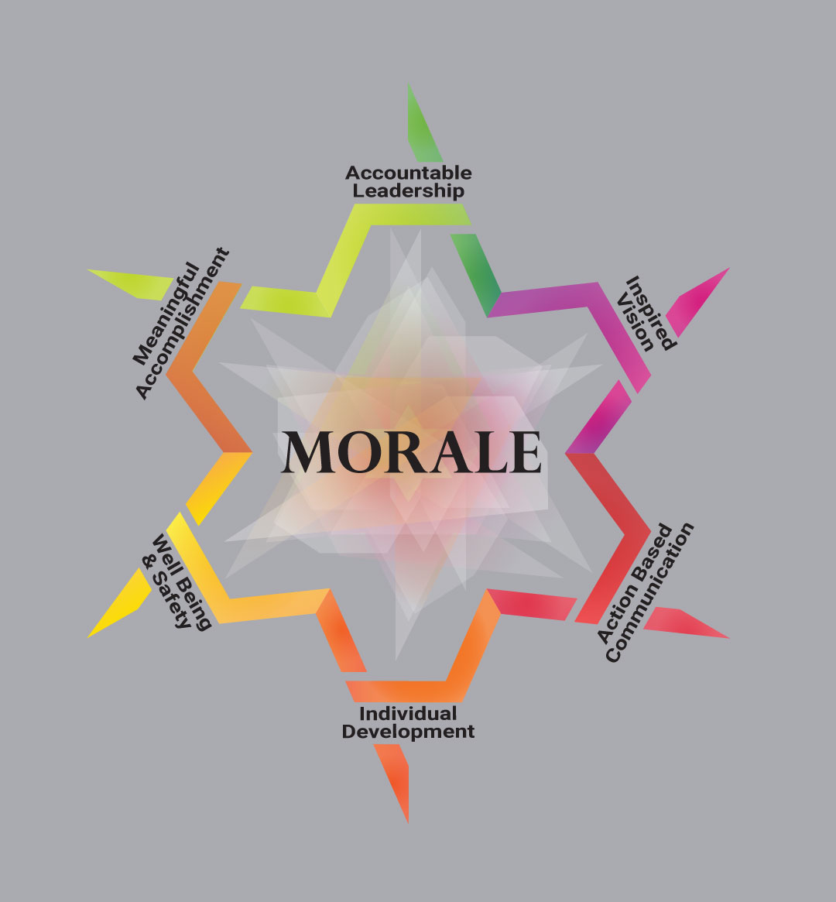

Slide 5
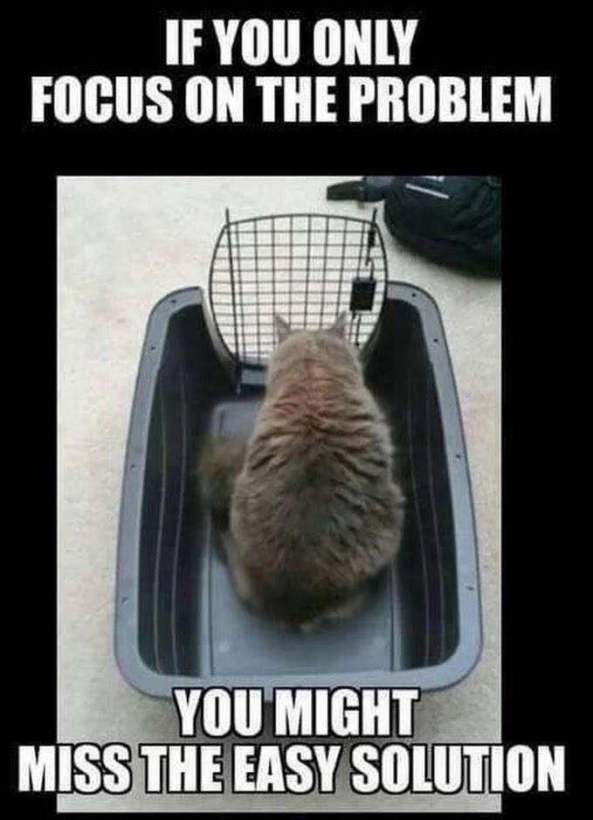
Problem Statement
The Parks, Recreation and Cultural Services Department Maintenance Division continues to be challenged in its day-to-day operations by antiquated systems, and an unpredictable, reactive, and growing workload. All exacerbated by the constantly changing environment of the pandemic.

Slide 6
What did that look like at the Shop?
Symptoms of bigger issues!
Reactionary Work
Lack of boundaries by Division leadership
Not working on park properties
Not prioritizing routine work
Lacking a sense of accomplishments
Unnecessary work
Maintenance Workers Were
Angry
Frustrated
Felt powerless
Unengaged
Uncaring
Distrustful of leadership (me)

Slide 7
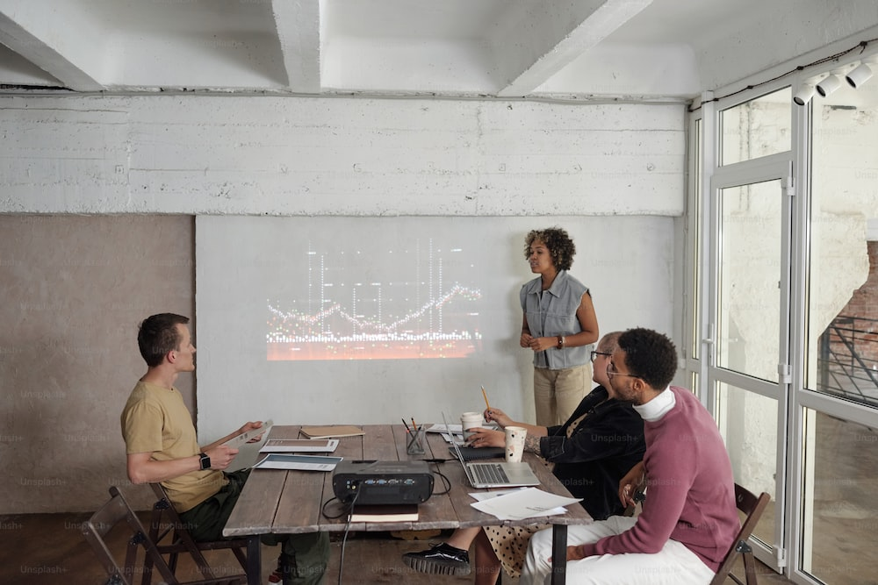
The Real Story
The Set up
The scarcity Mindset
Feuds, Failing and Frustrations
What is really going on?

Slide 8
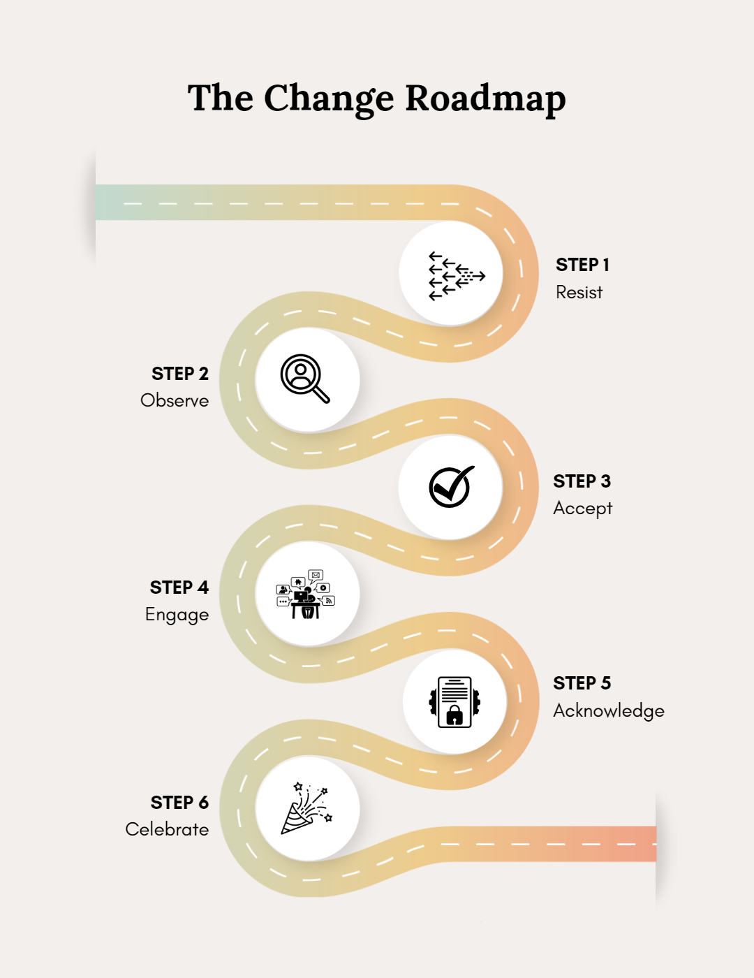

Slide 9
External Forces
Workplace Culture
Work Process
Using Systems
Operational Structure

Slide 10
Transitioning a Team
Fear
Certainty
Unfocused
Effective
Inconsistent
Service-Driven
Confused Message
Transparent
Isolated
Collaborative

Slide 11
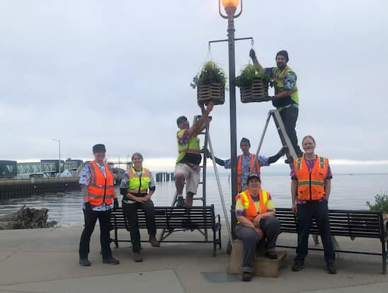
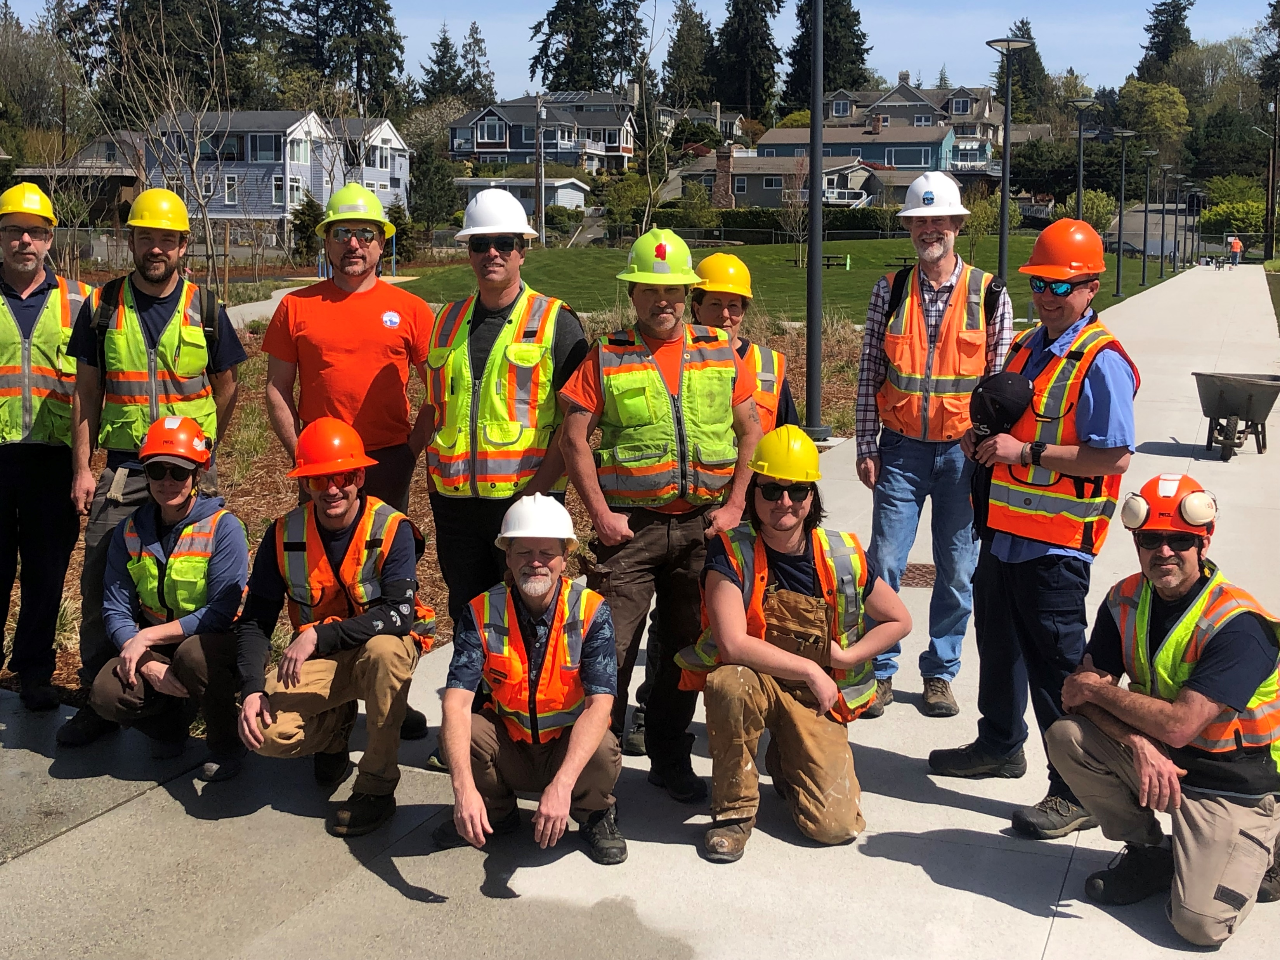
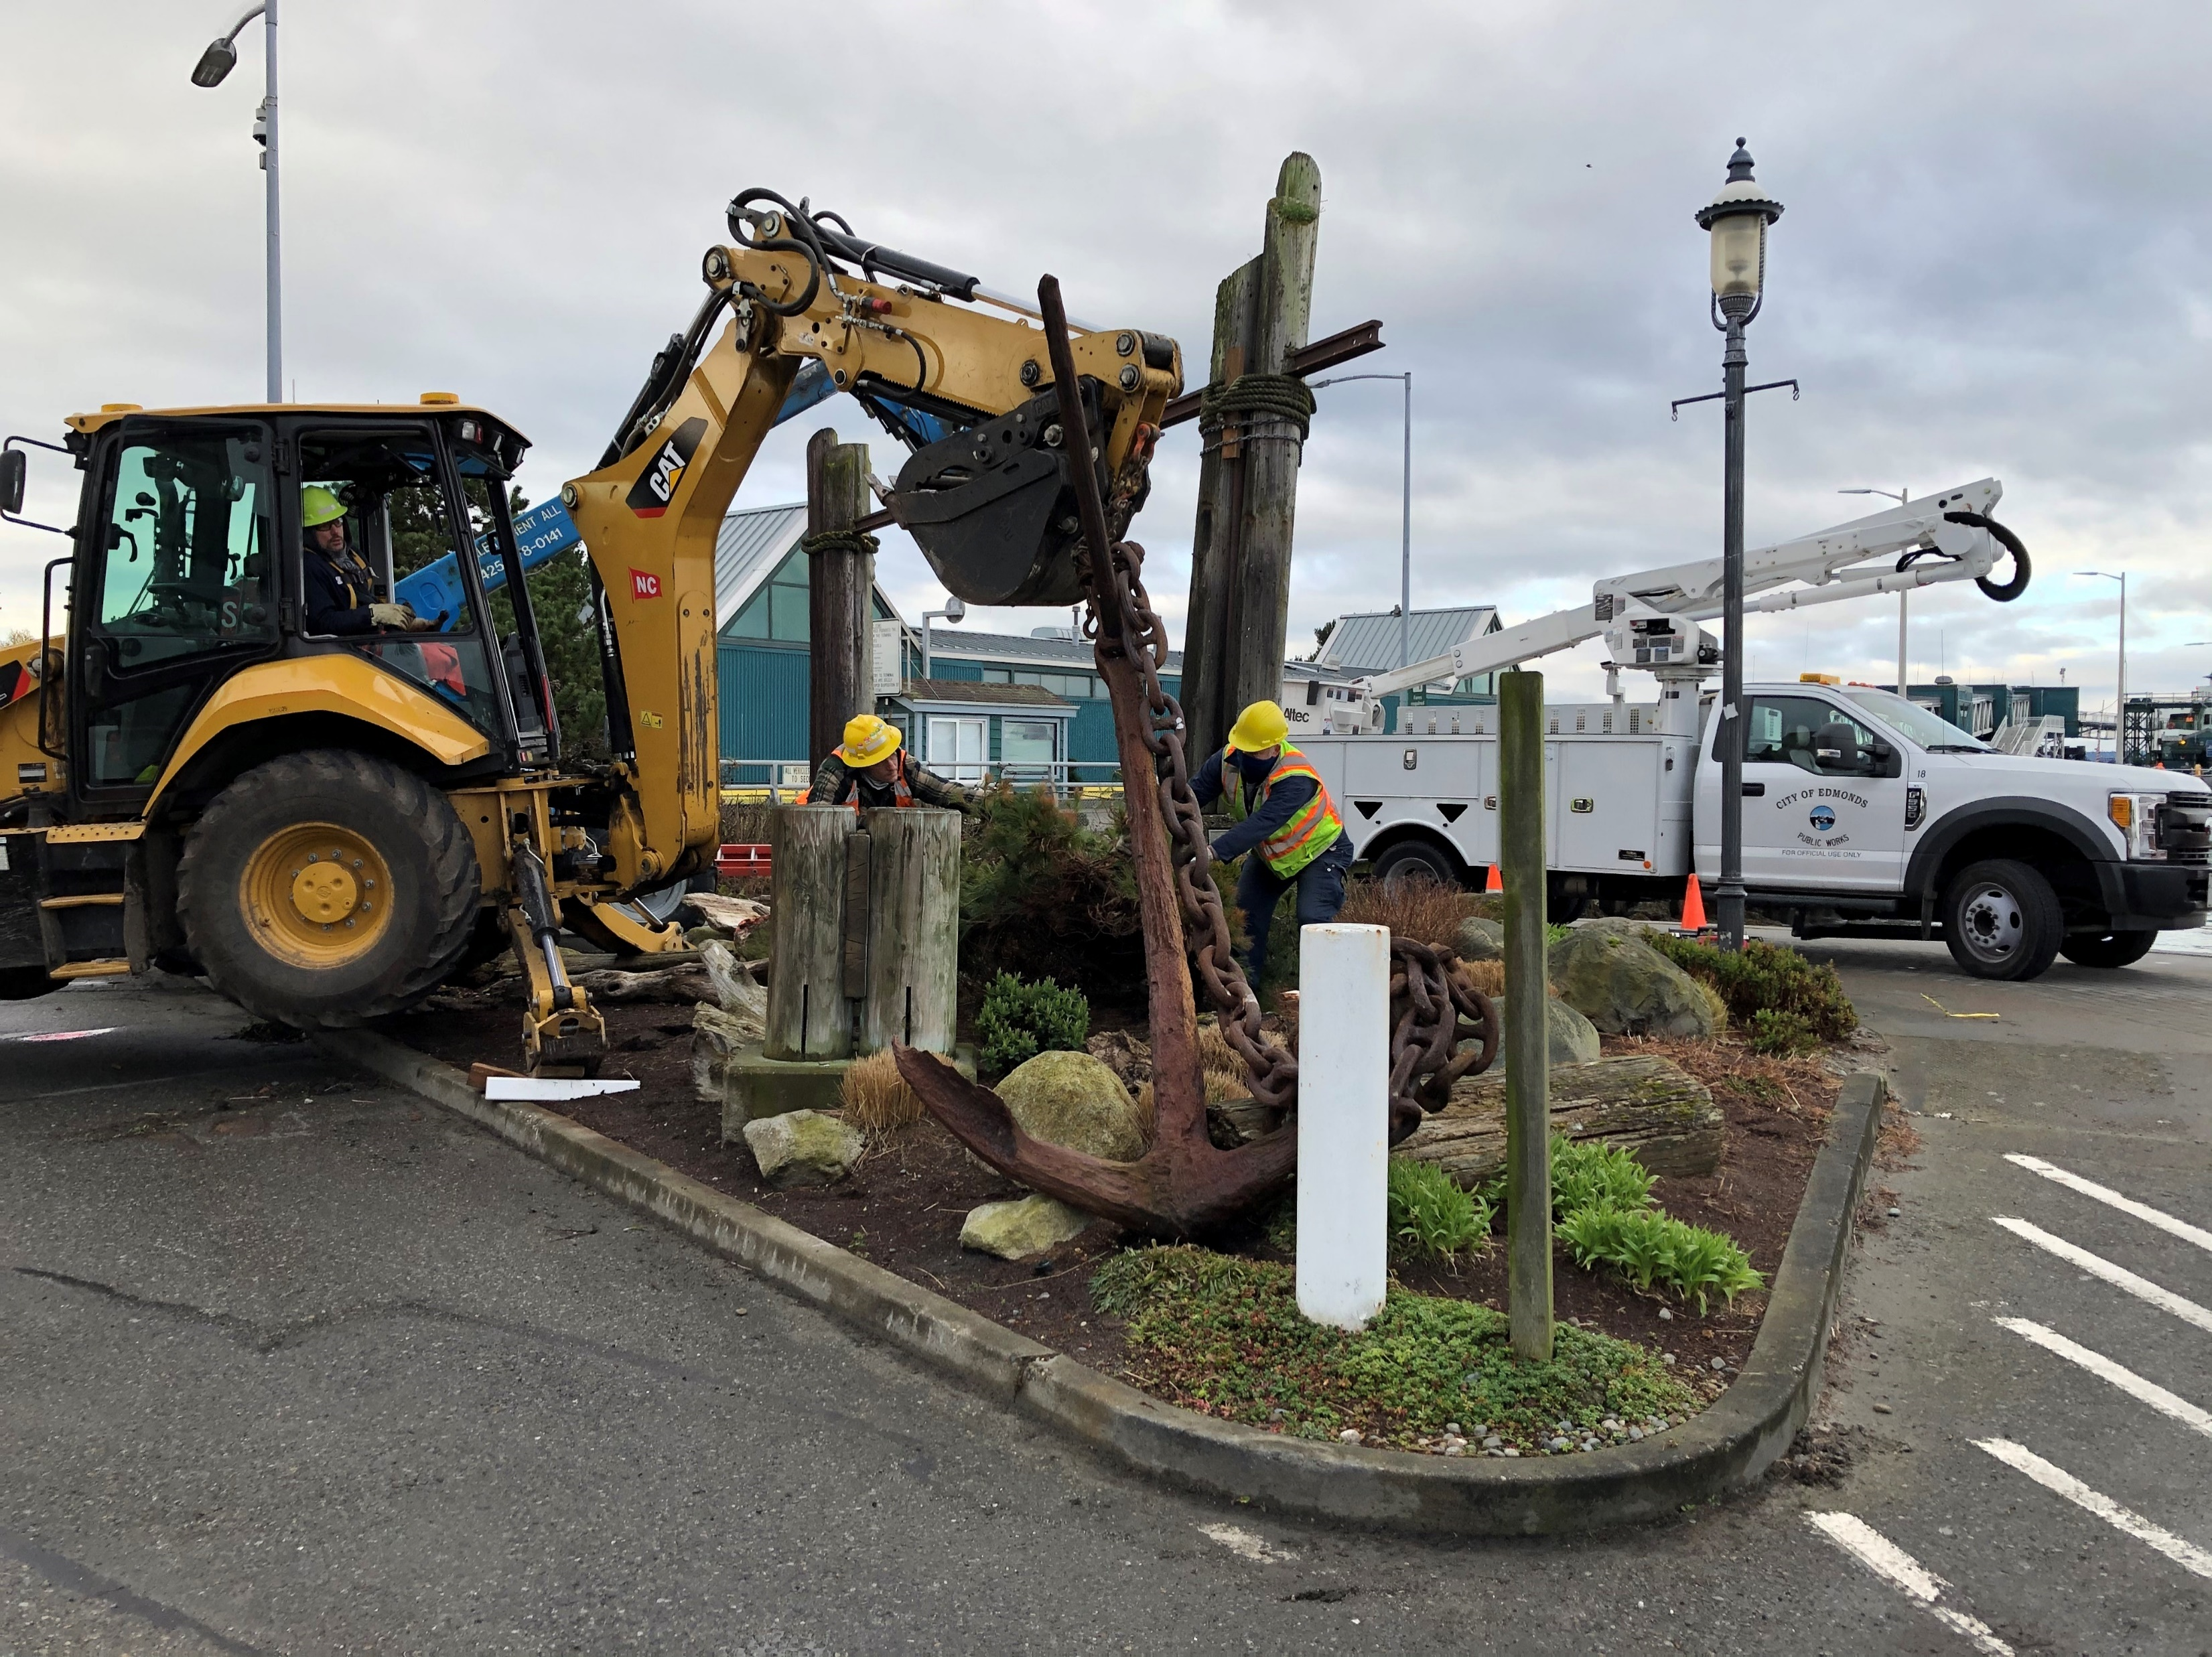
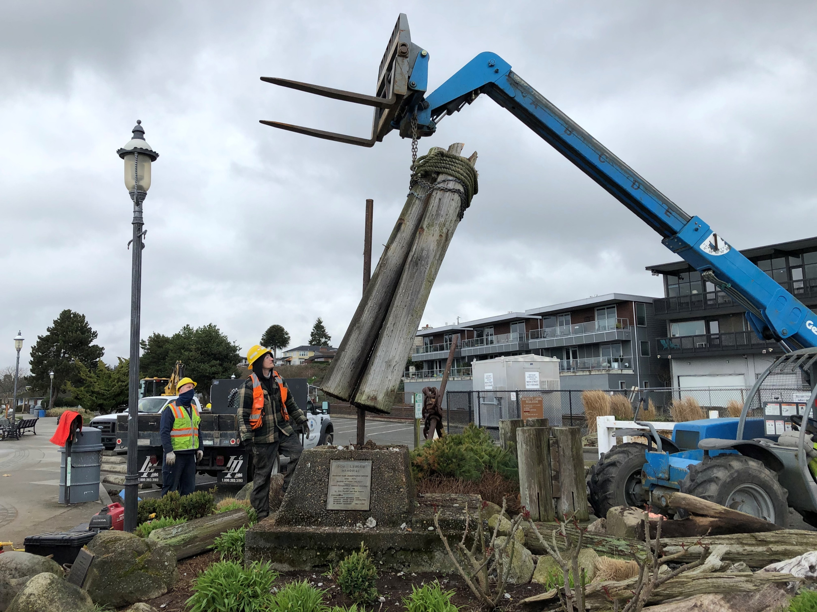
What was my role in this?
Showed up
Kept my promises and commitments
Honesty (brutally)
Shop visits
Involvement in department decisions & project reviews
Staff and budget resources (6 FTEs)
Transitioned leadership
Always “open-door”
Proactive Work
Boundaries by leadership
Working on park properties
Prioritizing routine work
Sense of accomplishments
Transitioned leadership
Only necessary work

Slide 12
The Keys
“If your product is bringing a bigger cultural change, it will take time but when that period of resistance is over, you will be able to reach the heights you’ve never even thought existed as Amazon did.” ― Pooja Agnihotri
Aligning Purpose
Vision
Defining a Season
Define Winning

Slide 13
The Keys
“If there is no transformation inside of us, all the structural change in the world will have no impact on our institutions.” ― Peter Block
Clarifying Roles
Debrief Constantly
Understanding the Flow of Performance
Planning for the Future

Slide 14
When did I know it was working?
December 20, 2022

Slide 15
